Slide 1
Annual Interagency Accessibility Forum
Unlocking the Power of Accessibility
October 13, 2022
A Different Perspective for Looking at Accessibility
Annette Carr

Slide 2

Presenter
Annette Carr
Disability Program Manager
Transportation Security Administration
Civil Rights & Liberties, Ombudsman and Traveler Engagement
Notes:
Facilitator Introduces DPM

Slide 3
Question 1
What is the leading cause of vision loss in the United States?
Birth defects
Macular Degeneration
Glaucoma
Cataracts
Diabetic Retinopathy

Slide 4
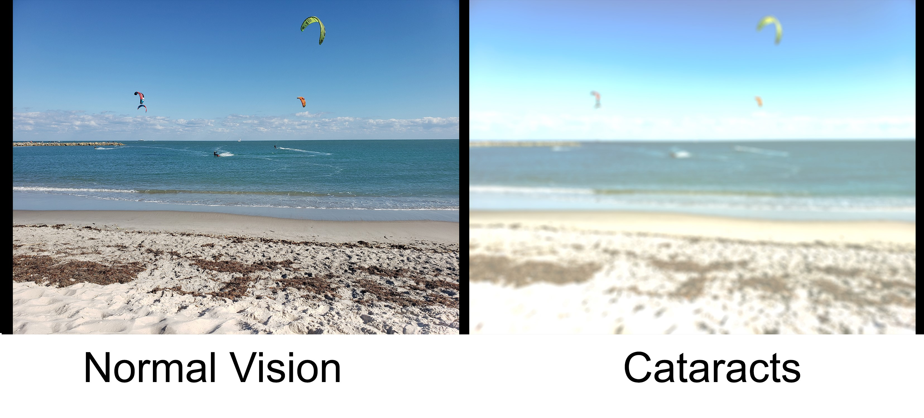
Answer 1
Correct Answer: d) Cataracts
Cataracts affect more than 24.4 million people in the United States age 40 and older. If left untreated, a person can become legally blind.

Slide 5
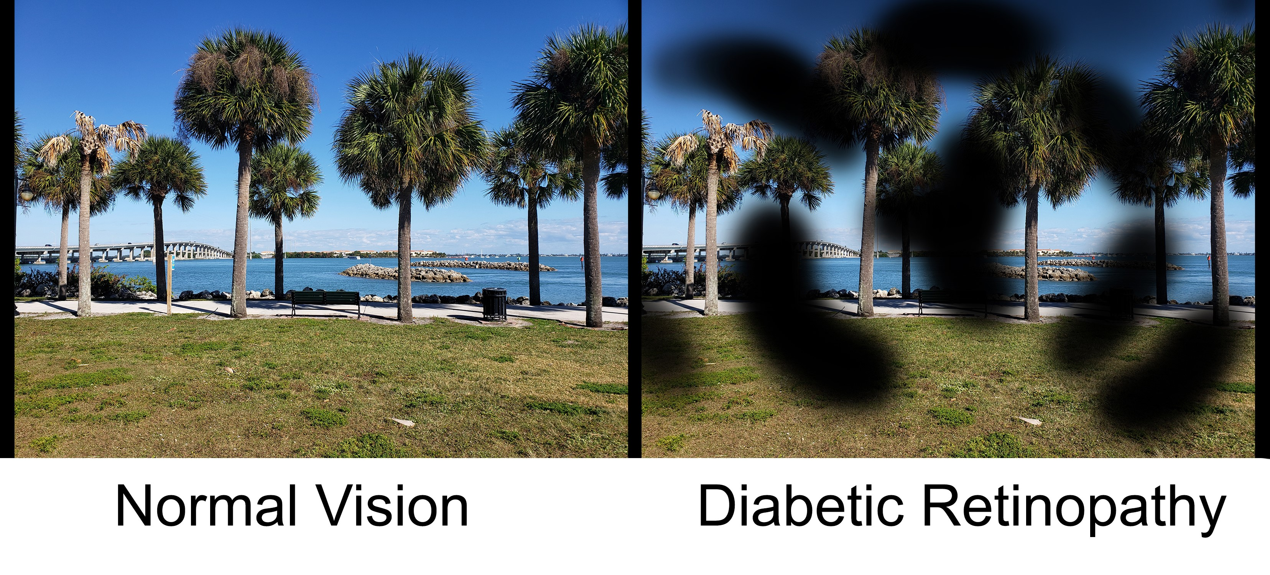
Diabetic retinopathy
Diabetic retinopathy is also a leading cause of vision loss:

Slide 6
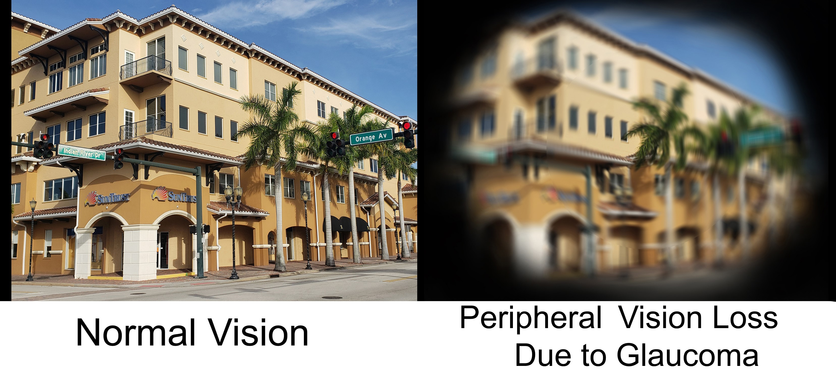
Glaucoma
Glaucoma is another leading cause of vision loss:

Slide 7
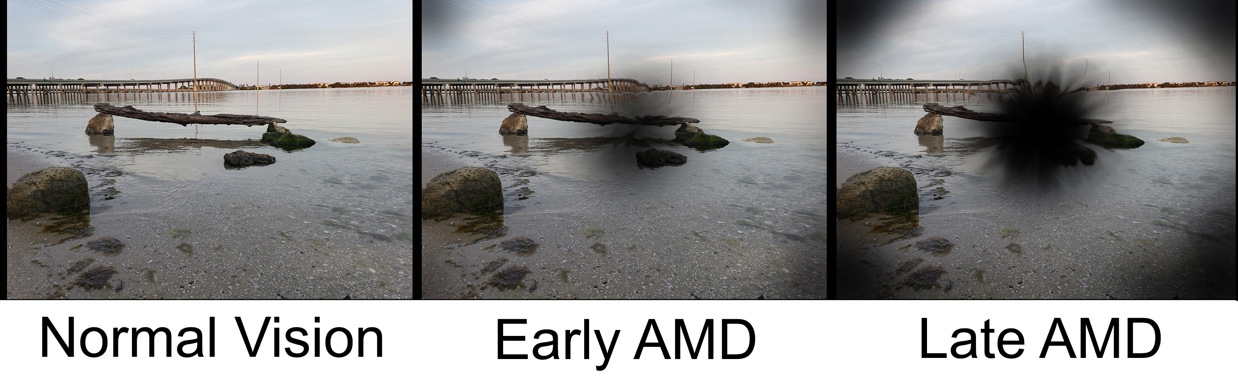
Age Related Macular Degeneration
Age Related Macular Degeneration (AMD) causes vision loss as well:

Slide 8
Common RA for Vision Loss
Screen magnification software
Screen reading software
Screen magnification software
Refreshable braille displays
Reader services
Alternative lighting

Slide 9
Workarounds for Blind/Visually Impaired
Rely on others to enter data requires building in extra time to get the job completed.
Limited access to assistance with MFP results in delay of completing task
Building in extra time to get scheduled reader services can delay the reading of documents
Convert files to other formats to work with refreshable braille displays
Print documents on 17” x 8.5” paper to enlarge print for reading when magnification software is not available
Lack of audio descriptions require making time to sit with a reader and re-listening to the video with someone describing visual content
Needing a crystal ball to predict what accommodations will be needed for meetings/workshops/trainings/conferences/etc.

Slide 10
Question 2
What is the most common cause of hearing loss in adults?
Aging & loud noises
Disease & illness
Unknown cause

Slide 11
Answer 2
Correct Answer: a) Aging and loud noises
Genetics and changes in the ear related to age play a significant role in age related hearing loss.
Chronic exposure to loud noises permanently damage the tiny hairs in the ear.
Some medical conditions can cause hearing loss, i.e. conditions that affect the blood supply to the middle ear, such as heart disease, high blood pressure, diabetes and other circulatory problems.
Side effects of certain medications, such as aspirin and antibiotics, can negatively affect hearing.

Slide 12
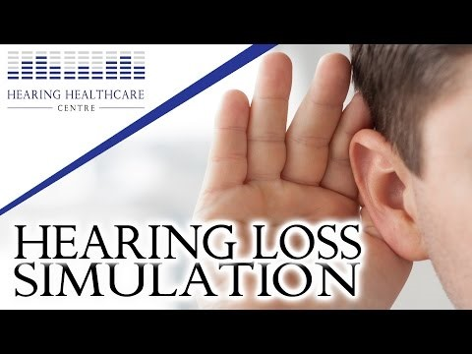
Hearing Loss Simulation

Slide 13
Common RA for Hearing Loss
Sign language interpreting
Captioning
Video phones
UbiDuo

Slide 14
Work-a-rounds for Deaf/Hearing Loss
Limited access to Video Phone, messaging applications, causes delay in interacting with others
Making time to re-read captioning transcript
Finding a way to get audio content of videos without captions
Lack of computer/mobile device based interpreting/captioning services when scheduled interpreting/captioning services are not available, limits interactions

Slide 15
Question 3
What is a print disability?
When you cannot see printed text
When you are unable to hold a hardcopy of printed material
When you have difficulty comprehending printed information because of a disability.
When your brain receives scrambled images of printed information?
Choices A & B
Choices C & D
All of the above

Slide 16
Answer 3
Correct Answer: G. All of the above
If a person has difficulty accessing and/or reading text because of a disability, they have a print disability. This includes:
Seeing the text
Holding the book or paper
Comprehension of the content
Visual processing of the content

Slide 17
Print Text Simulation – Unclear Text Font.
Our Mission
On January 18, 2017, the U.S. Access Board published a final rule updating accessibility requirements for information and communication technology (ICT) covered by Section 508 of the Rehabilitation Act and Section 255 of the Communications Act.
The U.S. General Services Administration (GSA) Office of Government-wide Policy (OGP) is tasked under this law to provide technical assistance to help Federal agencies comply with these requirements, and ensure that covered ICT is accessible to, and usable by, individuals with disabilities.

Slide 18
Print Text Simulation – Visual Distortion
Our Mission
On January 18, 2017, the U.S. Access Board published a final rule updating accessibility requirements for information and communication technology (ICT) covered by Section 508 of the Rehabilitation Act and Section 255 of the Communications Act.
The U.S. General Services Administration (GSA) Office of Government-wide Policy (OGP) is tasked under this law to provide technical assistance to help Federal agencies comply with these requirements, and ensure that covered ICT is accessible to, and usable by, individuals with disabilities.

Slide 19
Print Text Simulation - Normal
Our Mission
On January 18, 2017, the U.S. Access Board published a final rule updating accessibility requirements for information and communication technology (ICT) covered by Section 508 of the Rehabilitation Act and Section 255 of the Communications Act.
The U.S. General Services Administration (GSA) Office of Government-wide Policy (OGP) is tasked under this law to provide technical assistance to help Federal agencies comply with these requirements, and ensure that covered ICT is accessible to, and usable by, individuals with disabilities.

Slide 20
Print Text Simulation – High Contrast Beige/Black
Our Mission
On January 18, 2017, the U.S. Access Board published a final rule updating accessibility requirements for information and communication technology (ICT) covered by Section 508 of the Rehabilitation Act and Section 255 of the Communications Act.
The U.S. General Services Administration (GSA) Office of Government-wide Policy (OGP) is tasked under this law to provide technical assistance to help Federal agencies comply with these requirements, and ensure that covered ICT is accessible to, and usable by, individuals with disabilities.

Slide 21
Common RA for Print Disabilities
Braille
Large print
Text to speech technology
Book stand/holder
Automatic page turner
Word prediction software
Software that changes the appearance of text
Text to speech technology

Slide 22
Work-a-rounds for Print Disabilities
Convert files into other formats to use with text modifying software
Changing document attributes, i.e. font type/size, fore-ground and back-ground color combinations
Reading documents prior to meeting/workshop/training/etc. and memorizing content for recall during presentation/discussion
Waiting until after a meeting to read documents in an accessible format

